Slide 1
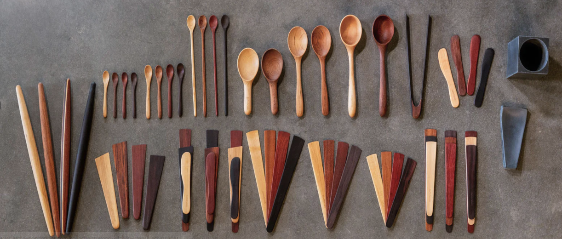

IS 731 Electronic Commerce
WOODEN KITCHENWARE
Asmita Dhananjay Deshpande
Campus ID: OF68333

Slide 2

1.About Us
2.Strategy of our company
3.B2C Business Model
Business Model for M-Commerce
Business Model for Collaborative Commerce
4.Cost Estimation
5.Graphical User Interface
Web User Interface
Mobile Interface
Table Of Contents

Slide 3
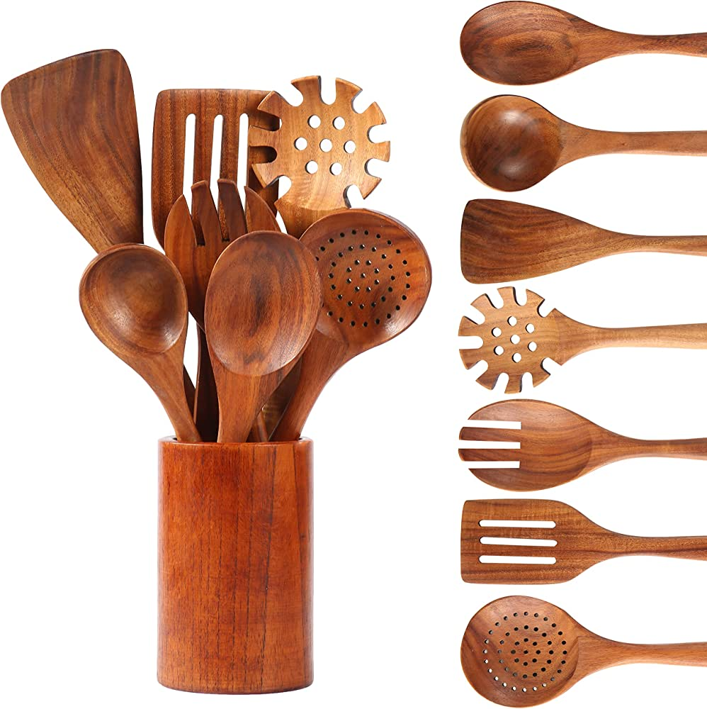
1. ABOUT US
Wooden Kitchenware is a virtual business-to-consumer (B2C) e-commerce company that’s specializes in selling sustainable and eco-friendly kitchen utensils made from high-quality wood.
Their mission is to provide customers with kitchenware that is not only functional and aesthetically pleasing but also environmentally responsible
Company which provides kitchenware - wooden kitchen utensils that are both functional and sustainable
Page 06
www.reallygreatsite.com

Slide 4
2. Strategy of the Company
PRODUCT DIFFERENTIATION
USER EXPERIENCE
MARKET AND COMPETITOR ANALYSIS
SUPPLIER RELATIONSHIPS
ONLINE PRESENCE
MARKETING AND VISIBILITY

Slide 5
3. B2B BUSINESS MODEL
Business Model for Collaborative Commerce
Business Model for M-Commerce
Freemium
Extend an existing business into the world
Service-based application
Subscription-Based Application
Sell affiliate products through your app
E-Tailing Business Model
Goods and services provider models
Collaborative models
Logistics Providers
Third Party Payment Gateway:

Slide 6
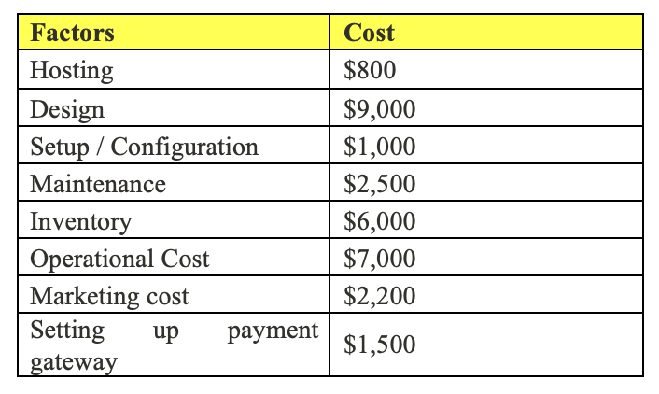
4.Cost Estimation

Slide 7
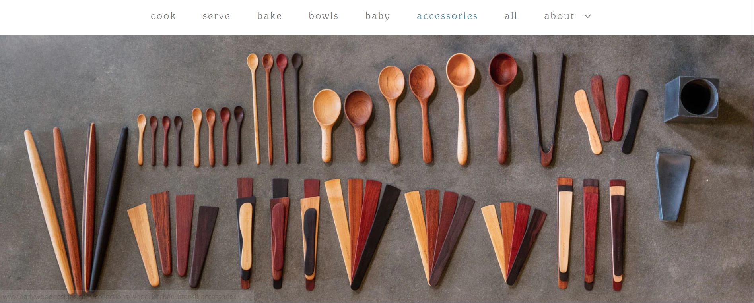
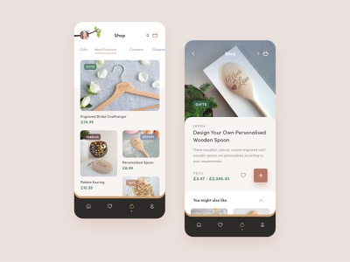


5.WEB INTERFACE AND MOBILE INTERFACE

Slide 8
THANK YOU

